Slide 1


Genomics Hackathon
Sat–Mon Oct 15-17th
Volunteer | Mentor
at hackseq.com
@hackseq

Slide 2
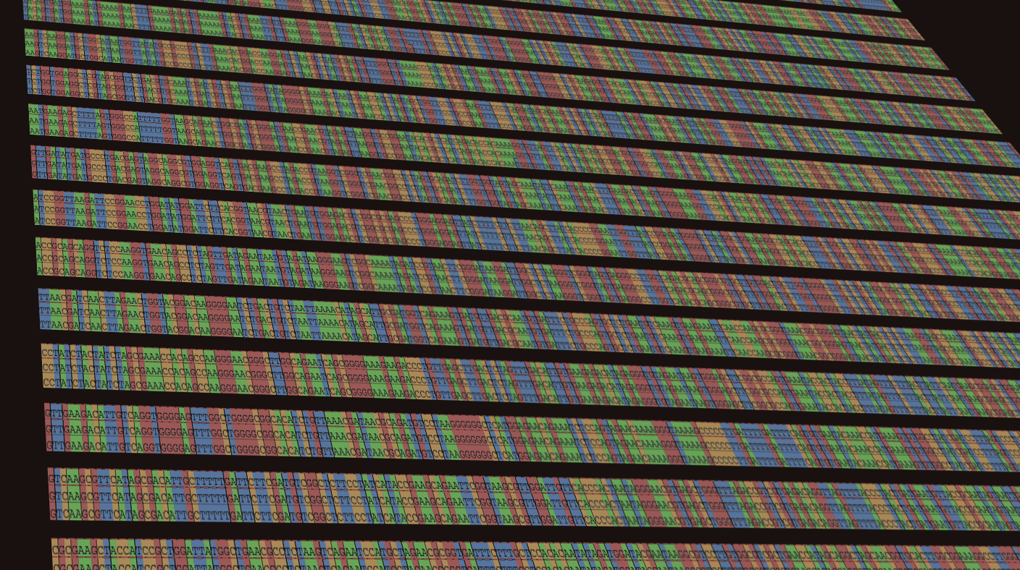
Genomics Hackathon
Sat–Mon Oct 15-17th
Volunteer | Mentor
at hackseq.com
@hackseq

